Slide 1
Lesson objective
Title: Posing questions
Aim – be able to:
Identify possible bias in surveys
Plan:
Review stratified sampling
Sentence level response

Slide 2
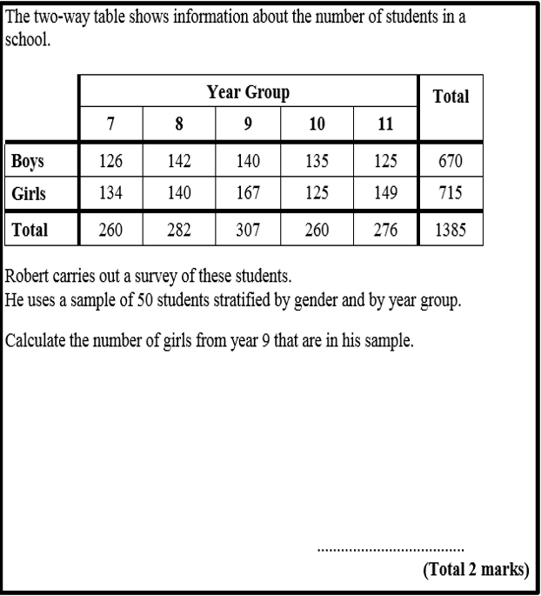
Divide members by total population
Multiply to sample amount (total number in survey)

Slide 3
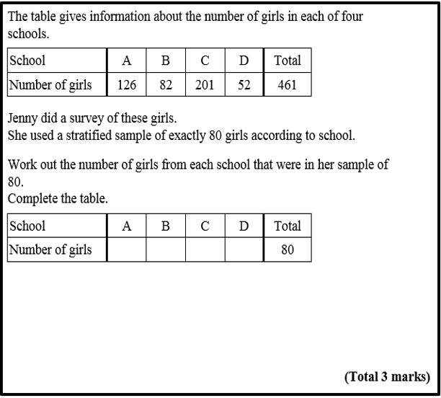
Divide members by total population
Multiply to sample amount (total number in survey)

Slide 4
Terminology
Bias / biasing: inclination or prejudice for or against one person or group, especially in a way considered to be unfair.
Majority: the greater number.
Minority: the smaller number
Glean: obtain (information) from various sources, often with difficulty.
Homogeneous: of the same kind; alike.
Proportion: a part, share, or number considered in comparative relation to a whole.
Gauging: estimate or determine the amount, level, or volume of.
The suffix ITY means quality, state, or degree.
‘Homo’ prefix meaning ‘same’
‘geneous’ comes from the root ‘genos’ meaning "kind, gender, race, stock"

Slide 5
Terminology
Bias / biasing: inclination or prejudice for or against one person or group, especially in a way considered to be unfair.
Majority: the greater number.
Minority: the smaller number
Glean: obtain (information) from various sources, often with difficulty.
Homogeneous: of the same kind; alike.
Proportion: a part, share, or number considered in comparative relation to a whole.
Gauging: estimate or determine the amount, level, or volume of.

Slide 6
What is wrong with this question?
No Time Frame
Overlapping Options
How many times do you go to the gym?
1 – 5
5 – 10
10 – 15
15 – 20
What if you don’t use the gym?
What if you use the gym more than 20 times?
Notes:
There are at least 4 things wrong with this question. Give students a minute to discuss the question with their neighbour to see if they can identify the mistakes.

Slide 7
What is wrong with this question?
Emotive Language
Given than smoking kills millions of people each year, don’t you agree that it should be banned?
Leading Question
Yes
No
No option for those without an opinion/undecided
Notes:
There are at least 3 things wrong with this question. Give students a minute to discuss the question with their neighbour to see if they can identify the mistakes.

Slide 8
What is wrong with this question?
No Time Frame
Ambiguous options
How often do you walk your dog?
Quite A lot
Never
A lot
Regularly
All the time
Overlapping options?
What if you don’t own a dog?
Notes:
There are at least 4 things wrong with this question. Give students a minute to discuss the question with their neighbour to see if they can identify the mistakes.

Slide 9
Selection bias, where the results are skewed a certain way because you’ve only captured feedback from a certain segment of your audience.
E.G :
Only asked old people or gender specific
Chosen a time or day that would NOT be inclusive
Response bias, where there’s something about how the actual survey questionnaire is constructed that encourages a certain type of answer, leading to measurement error.
E.g.
Leading question
Choices for response are poorly displayed or arranged

Slide 10
Think
A survey is conducted asking 100 randomly selected adults how many children they have.
Which method could lead to bias? Why?
Asking people waiting outside a primary school at 3pm
Randomly selecting people at a night club
Randomly choosing 100 adults from the national census

Slide 11
Write a potential bias
Mr. Brown wanted to find out if the road through Stonehouse was dangerous. He counted the number of cars driving up the high street for two hours on a Sunday afternoon.

Slide 12
Write a potential bias
A company wants to find out how much people are prepared to spend on a new TV. They survey 5000 people on the internet via social media.
- Think: what would make you want to do a survey online?

Slide 13
Write a potential bias
Mr. Davies wanted to know whether students should be allowed wear hats inside. He asked 10 people in the staffroom.

Slide 14
Write a potential bias
Eating 5 veg and 2 fruit daily helps improve quality of life, do you think students should receive free lunch if its healthy?
Yes
no

Slide 15
Write a potential bias
Eating 5 veg and 2 fruit daily helps improve quality of life, how often do you eat vegetables?
yes
no
sometimes

Slide 16
Page 361

